Slide 1
What is the big deal
KUL 4.0 IIOT
Jan van Deventer

Slide 2
The Internet
A network of networks.
More specifically, it is a global system of interconnected computer networks that uses the Internet protocol suite (TCP/IP) to communicate between networks and devices.
It transports INFORMATION or data rapidly from one point to another.
When the information is correct, it makes the modern world go round.
Most illustrations are from Wikipedia

Slide 3

What is the big deal with the Internet?
Looking at some attributes
Cost,
Speed,
Availability,
Reliability,
Security,
Scalability,
Proven technology,
Duality of simplicity and complexity.

Slide 4

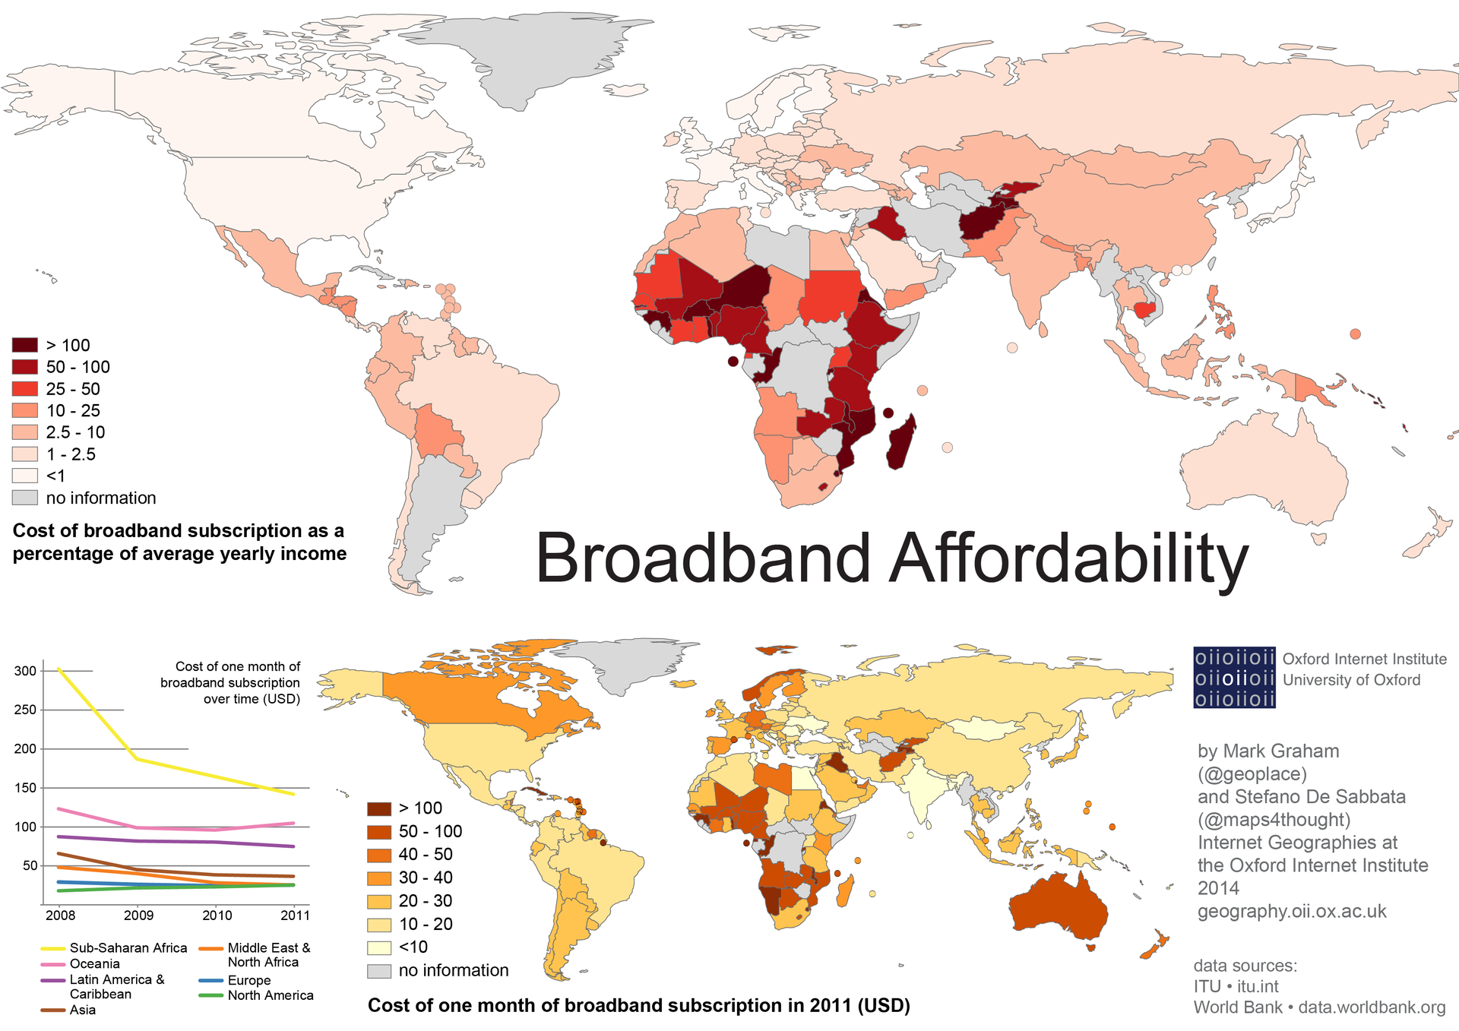
Apparently just about free
Access to the Internet is just about free
There exists free hotspots
Access subscription
Mobile access subscription
Cost of computer
Cost of mobile phone
Routers and cable

Slide 5
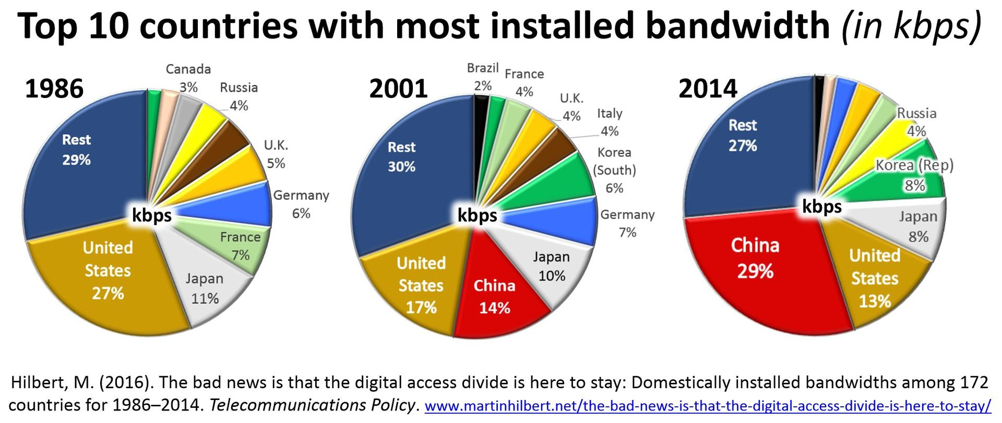
Internet Speed
The bit rates for dial-up modems range from as little as 110 bit/s in the late 1950s.
64 kbit/s (V.90 and V.92) in the late 1990s.
https://fast.com to see your current one.
Streaming live shows.

Slide 6
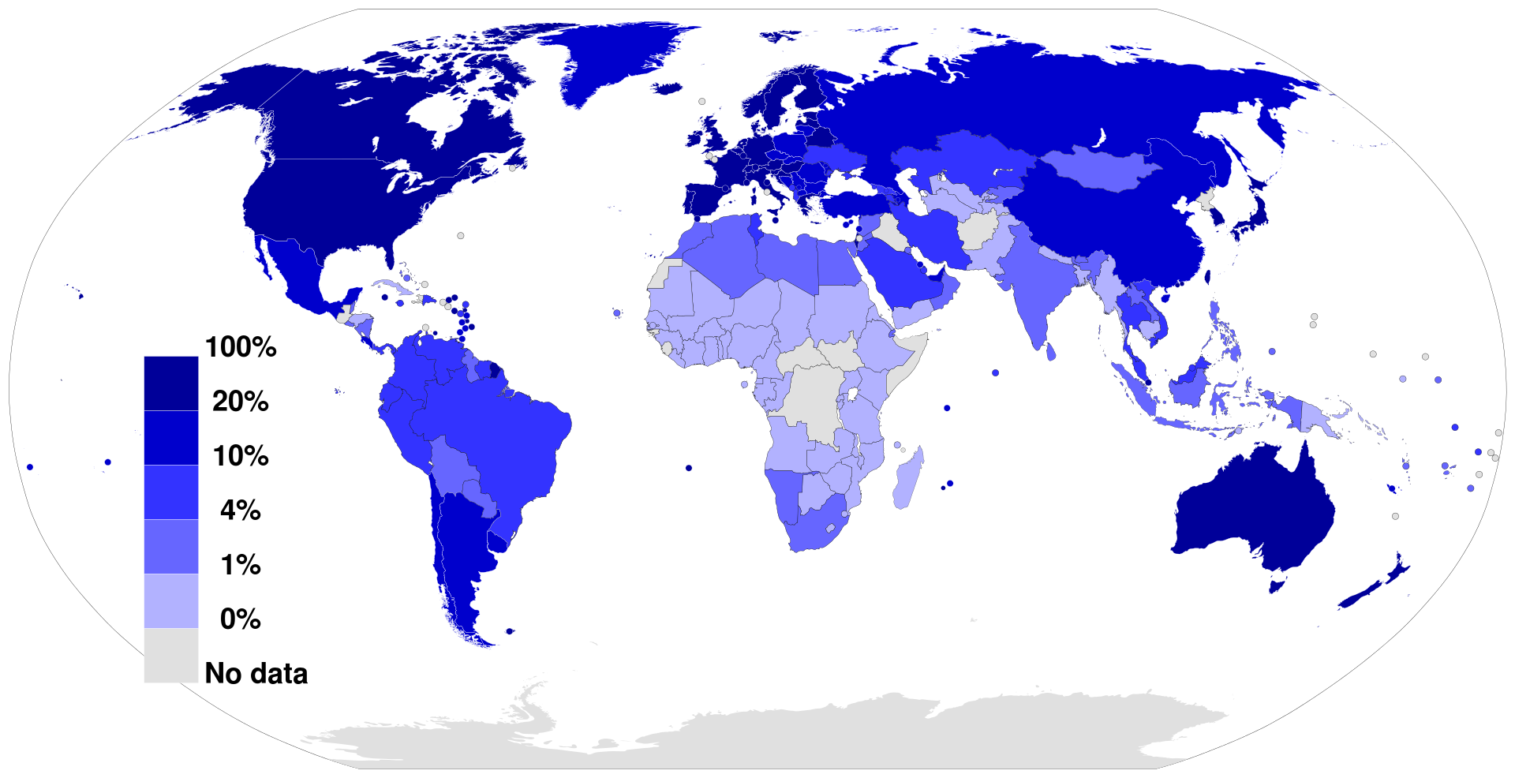
Fixed broadband Internet subscriptions in 2012 as a percentage of a country's population
Source: International Telecommunications Union

Slide 7
Animation demonstrating data packet switching

Slide 8
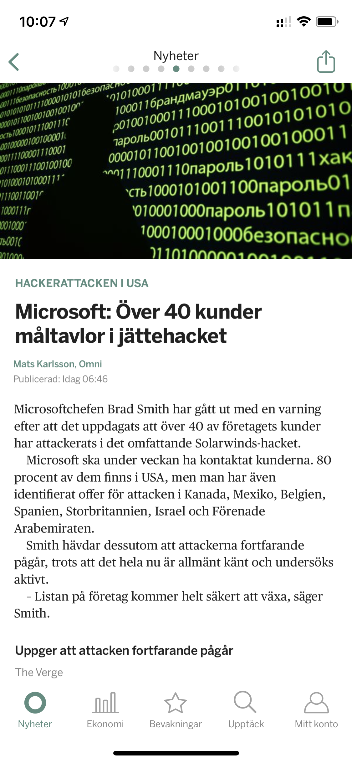
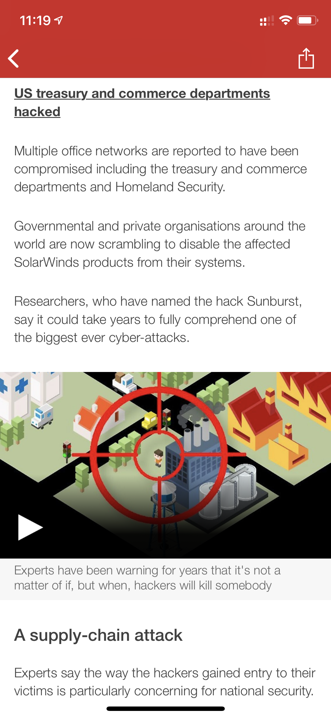
Secure?
Do you use Internet Banking?
All your life savings are there?
Screenshots from BBC and Omni

Slide 9
Scalable
IPv4 :Internet Protocol version 4
IPv4 uses a 32-bit address for its Internet addresses,
2^32 IP addresses in total around 4.29 billion.
IPv6 : next generation Internet Protocol address standard
IPv6 128-bit Internet addresses,
1028 times the number of devices.
IPv4 and IPv6 are not compatible and exist in parallel.

Slide 10
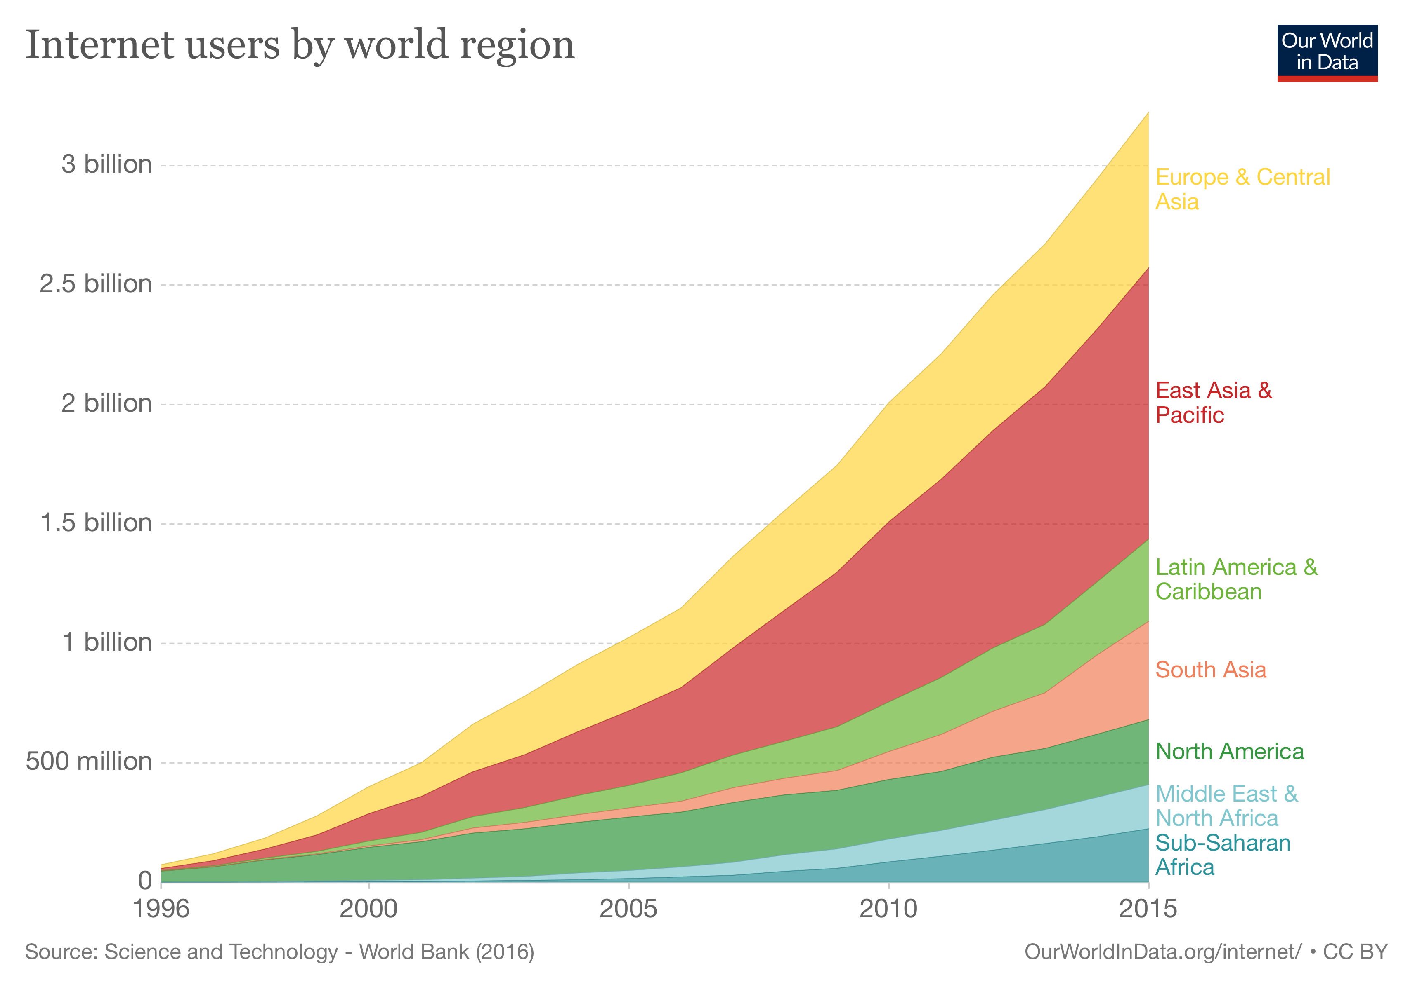
The number of users on the Internet from 1996 to 2015, grouped by region
https://ourworldindata.org/grapher/internet-users-by-world-region

Slide 11
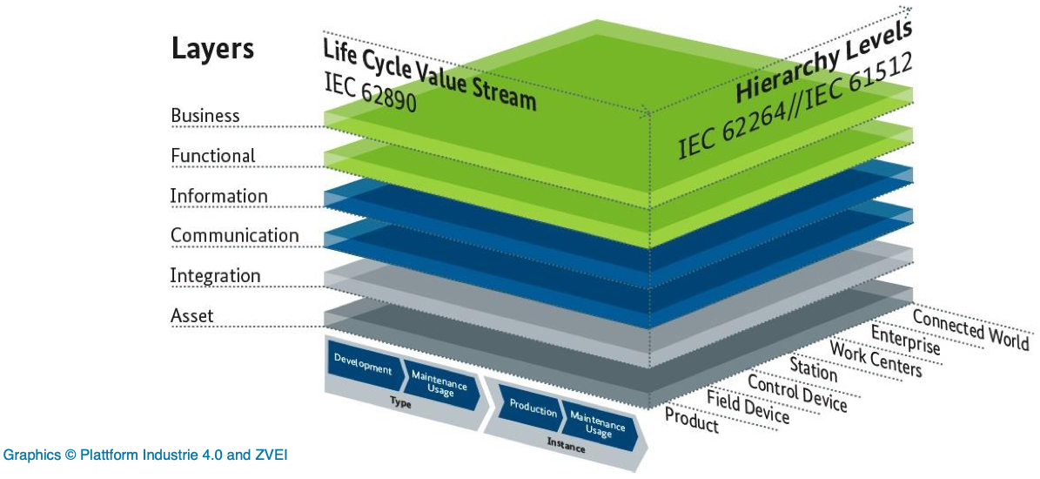
RAMI 4.0

Slide 12
The big deal is
that the Internet gives us access to more and more information in at a seemingly low cost and in a reliable manner.

